Slide 1
Github

Slide 2
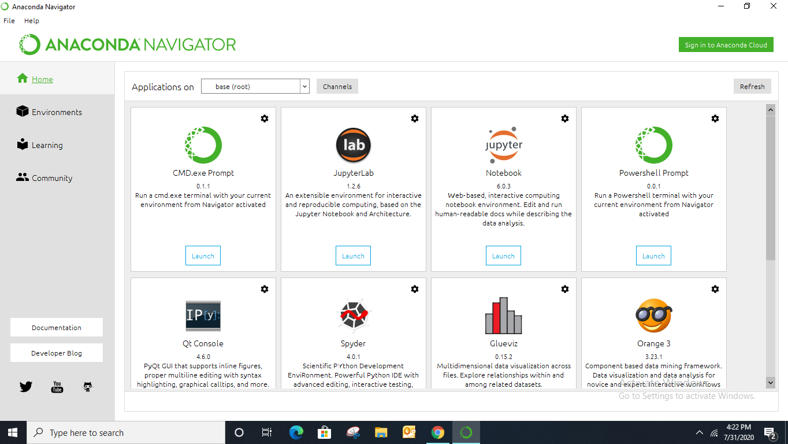
Anaconda

Slide 3
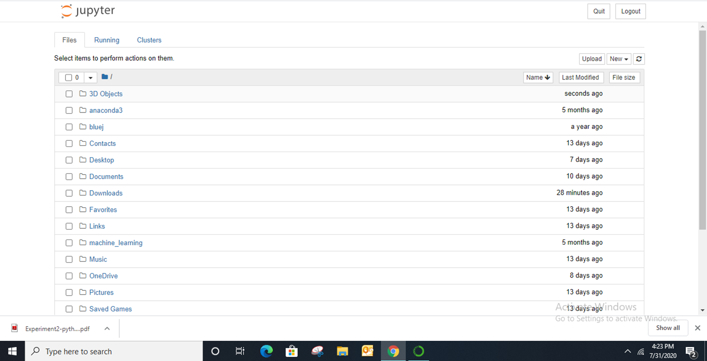
Juypter notebook

